Slide 1
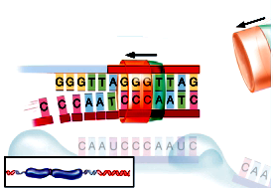
After
DNA polymerase

